Slide 1


Las Vegas Hotel Recommendation
- Presented by
Suvarna Joshi (hf2351)
Nalisha Rathod (gs9440)

Slide 2
Loading The Data
We use the Las Vegas Strip Data Set data set that was obtained from the UCI Machine Learning Repository. According to the data source, the data contains 504 instances, 20attributes and is fit for undertaking classification and regression tasks.
Loading up the data using the readr::read_delim() function that best captures the delimiter of the data. The data can best be separated and described based on the user and the facilities and ratings of the hotel.

Slide 3
Data Cleaning
We then check for missing and inconsistent values within our data.
Inconsistent values
User country Nr. reviews Nr. hotel reviews Helpful votes Score Member years
USA 17 9 16 5 -1806
The data contains a rather peculiar value in the midst of the Member years column of -1806 that we can assume may be an input error or may be just a dummy for missing value. However, proceeding on we shall exclude it when undertaking algorithm analysis.

Slide 4
Data Visualization
Count of hotel users by country
Syntax:
Output:

Slide 5
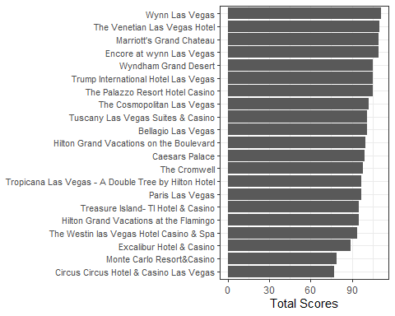
Data Visualization
Total Score for hotels
Syntax:
Output

Slide 6
Data Preparation
We filter out the unnecessary data for undertaking our analysis.
For Example: If we consider the ‘User Country’, We can assign 1 to Australia and 2 for Belgium as alphabetically A comes before B. In short, its just assigning numeric values / levels
Conversion of data Points to factor values

Slide 7

Algorithm Selection
Naive Bayes
Naive Bayes (NB) is 'naive' because it makes the assumption that features of a measurement are independent of each other.
Library(e1071) – This is the library or Department of Statistics which includes SVM

Slide 8
Naive Bayes
The output contains the apriori probabilities of the Score values, then the conditional probabilities of each class as a function of predictor values. The algorithm computes the probability that the score will be either of the 5 unique score values.

Slide 9
Confusion Matrix and Statistics
The model has an overall accuracy of 60.47% for the training data set
## Confusion Matrix and Statistics ## ## Reference ## Prediction 1 2 3 4 5 ## 1 3 0 1 1 1 ## 2 0 7 4 0 5 ## 3 0 2 20 8 10 ## 4 1 1 9 47 20 ## 5 2 6 11 37 105 ## ## Overall Statistics ## ## Accuracy : 0.6047 ## 95% CI : (0.5469, 0.6603) ## No Information Rate : 0.4684 ## P-Value [Acc > NIR] : 1.435e-06
The model has 40.59% accuracy for the validation data.
## Confusion Matrix and Statistics ## ## Reference ## Prediction 1 2 3 4 5 ## 1 0 0 0 0 1 ## 2 1 1 3 6 2 ## 3 0 3 4 13 8 ## 4 0 4 8 18 15 ## 5 4 6 12 34 59 ## ## Overall Statistics ## ## Accuracy : 0.4059 ## 95% CI : (0.3376, 0.4771) ## No Information Rate : 0.4208 ## P-Value [Acc > NIR] : 0.69

Slide 10

Random Forest Algorithm
## Confusion Matrix and Statistics ## ## Reference ## Prediction 1 2 3 4 5 ## 1 0 0 0 0 0 ## 2 0 0 0 2 0 ## 3 1 1 4 14 3 ## 4 1 5 12 22 27 ## 5 3 8 11 33 55 ## ## Overall Statistics ## ## Accuracy : 0.401 ## 95% CI : (0.3328, 0.4721) ## No Information Rate : 0.4208 ## P-Value [Acc > NIR] : 0.7386

Slide 11
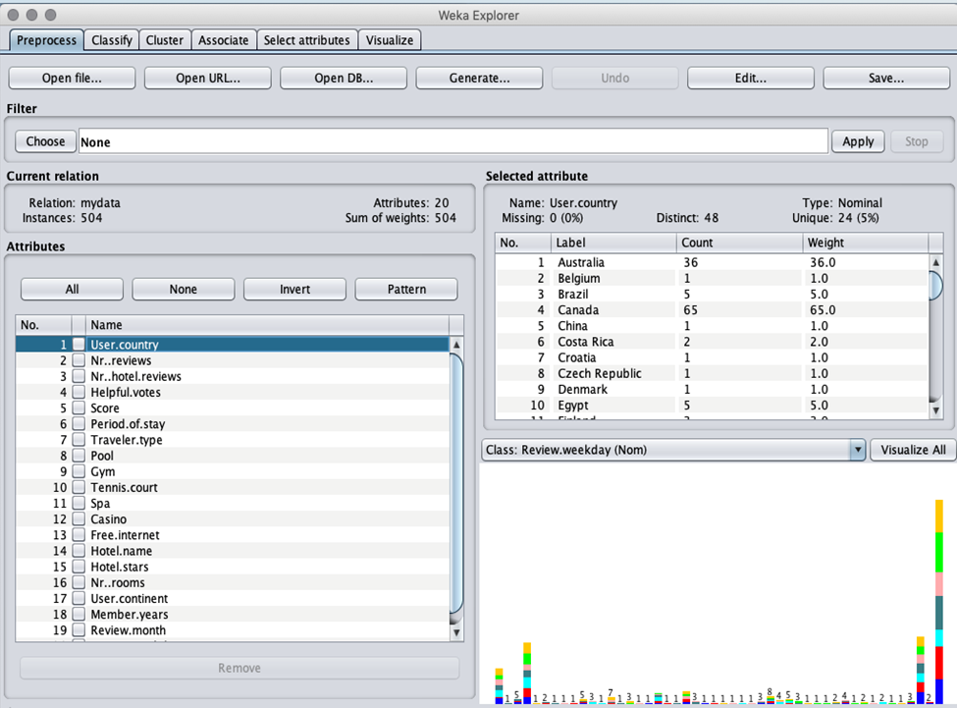
Data Preprocessing with WEKA

Slide 12
Data Cleaning In Weka
Make numeric attribute nominal

Slide 13
Data Cleaning in Weka
Handle outliers
Filter option in WEKA I used to detect any outlier
Preprocess Tab → Choose Filter → Filter → unsupervised → attributes → InterquartileRange → Apply
We select score as the class Attribute.

Slide 14
Data Visualization

Slide 15
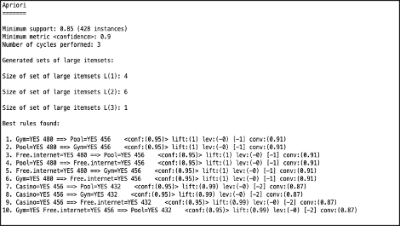
Association Analysis

Slide 16
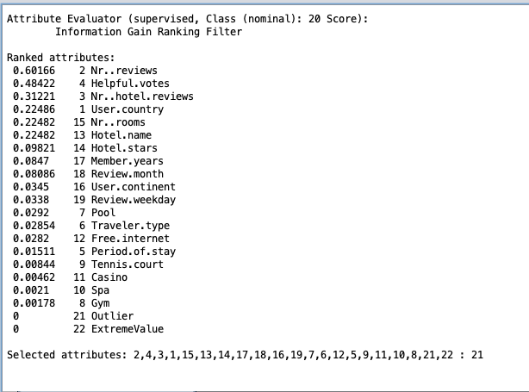
Information Gain
Maximum gain is from ‘Number of reviews’ attribute. This attribute is most important attribute because traveler will decide hotel based on number of reviews.

Slide 17
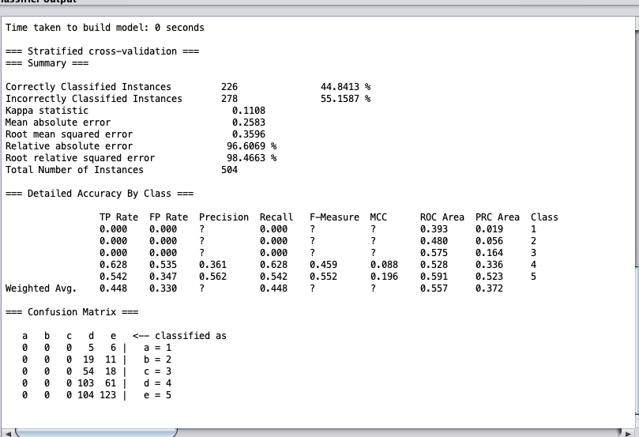
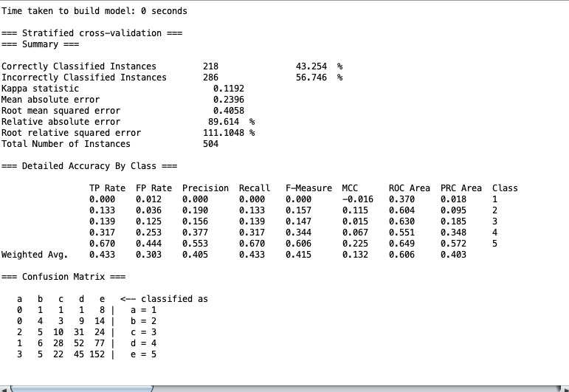
Algorithms
Naive Bayes
Boosting

Slide 18
K – Means Clustering Technique
Simple K Means clustering technique -
=== Model and evaluation on training set ===
Clustered Instances
0 330 (65%)
1 174 (35%)

Slide 19
Conclusion
Based on the accuracy, the naive bayes with 60.47 and the random forest at 40.1, we can use the naive bayes to provide better prediction of the Score, and therefore able to select and recommend a better hotel based on the attributes required. The metrics for effectiveness of models were based on the results provided by accompanying functions of the algorithms.
Different data mining techniques used on the LasVegas strip dataset. We implement pre-processing filters like numericToNominal, selecting class label. Also handle the attribute which has has multiple values in a columns(hotel.star). Applied association analysis with Apriori algorithm. Applied classification techniques like Naïve Bayes and Boosting, also performed Clustering, Attribute selection on dataset.

Slide 20
THANK YOU

